Slide 1


DWH for hotels’ booking Analysis
Exit task for DWH & ETL module Hanna Hul
DECEMBER 2, 2017

Slide 2



TARGET AUDIENCE
Analysts, managers, owners,
marketing expert of
hotel booking sites
hotels

Slide 3
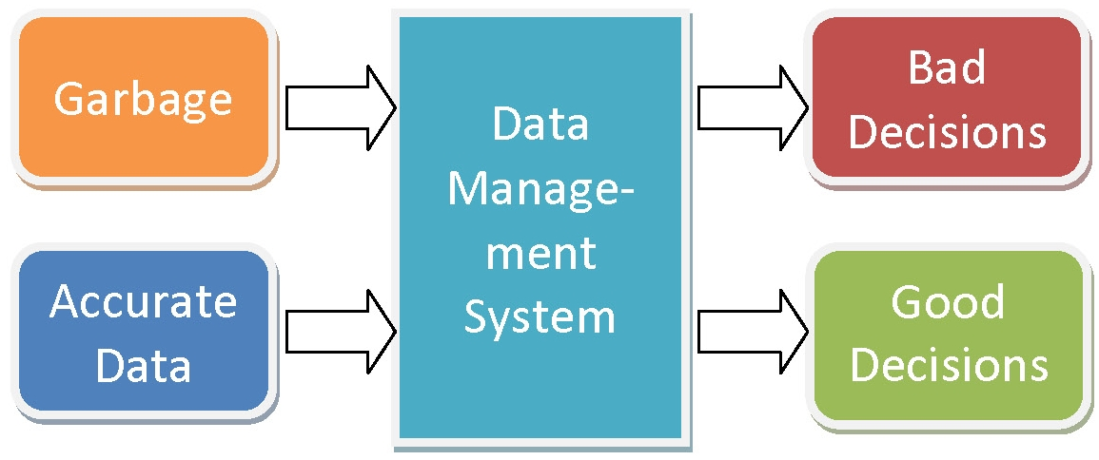
Problems because of poor data management

Slide 4

Benefits of DWH implementing
If you have actual data, your clients will be yours forever
The DWH gives the possibility to follow clients’ demand. You will be ahead, not behind your clients.
Marketing
Reporting improvement or implementing

Slide 5
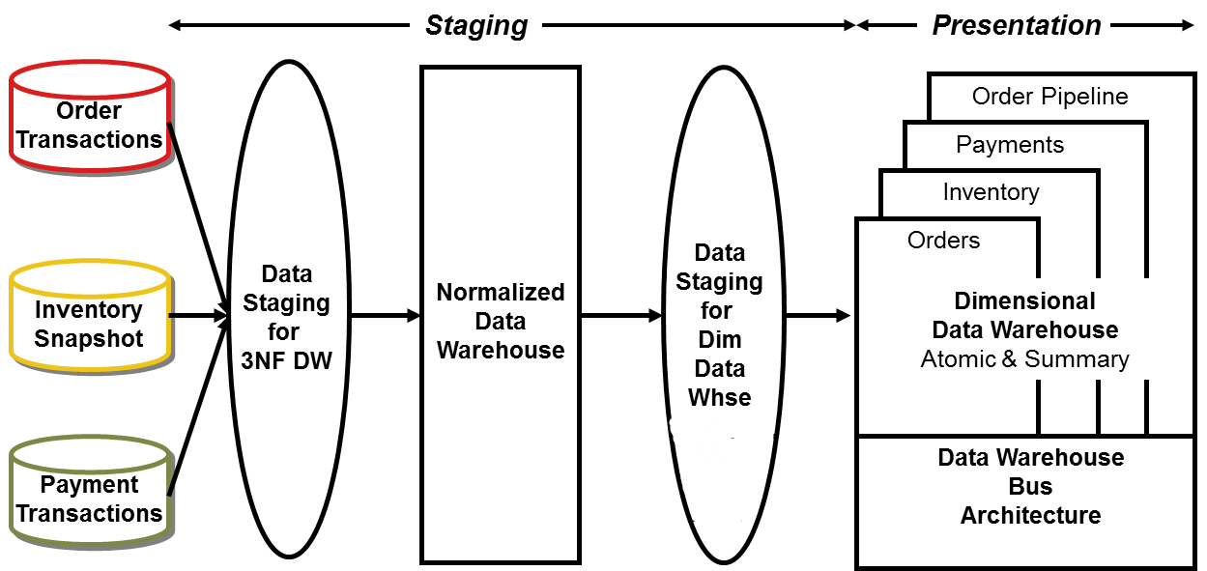
Data Flow

Slide 6
Data sources
.csv/.txt files
Bank names
Customers with the locations
Hotels
Dbms_random.NORMAL() ,
Dbms_random.value() ,

Slide 7
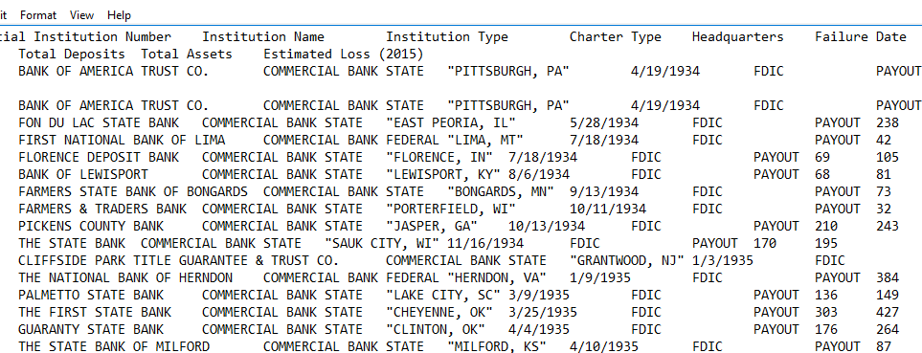

Slide 8
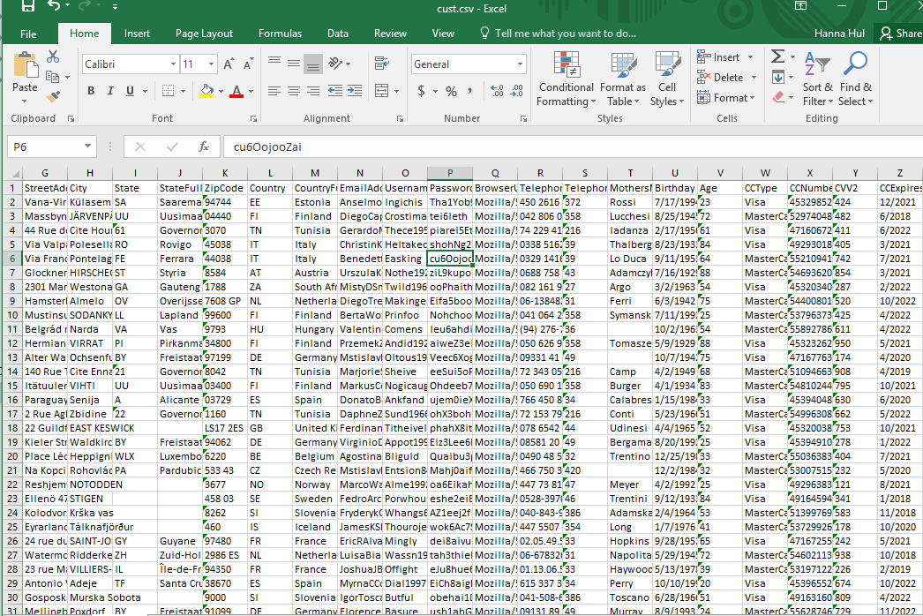

Slide 9
Data generation
Abs ( round ( DBMS_RANDOM.normal * 8000 + DBMS_RANDOM.normal * 1000 + DBMS_RANDOM.normal * 100 + 9000 ) ),
TRUNC ( sysdate + dbms_random.value ( -1500, 1500 ) ),
ROUND ( ABS ( dbms_random.normal *
( SELECT COUNT ( * ) FROM bl_3nf.ce_hotels ) / 20) + dbms_random.value ( 0.51, ( SELECT COUNT ( * ) FROM bl_3nf.ce_hotels ) /5 ) ) AS hotel_id,

Slide 10
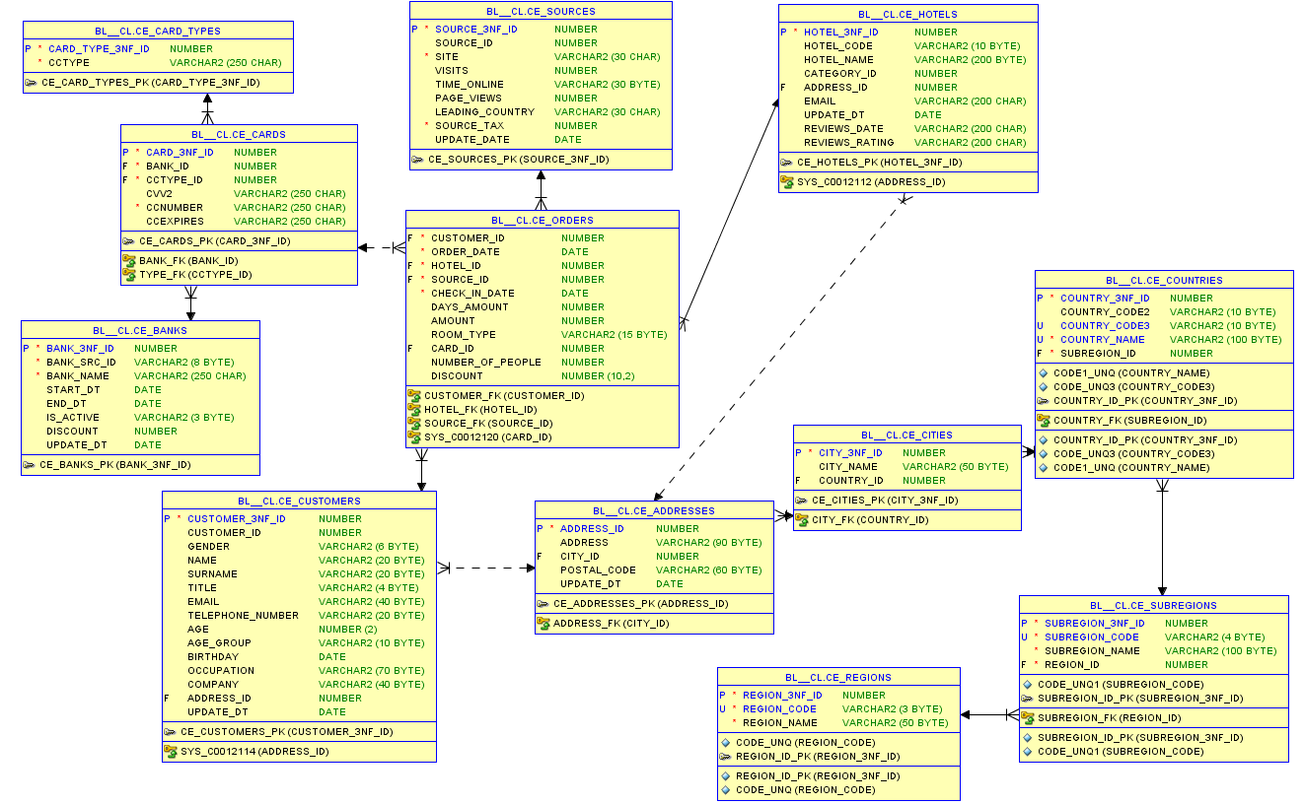
3nf layer

Slide 11
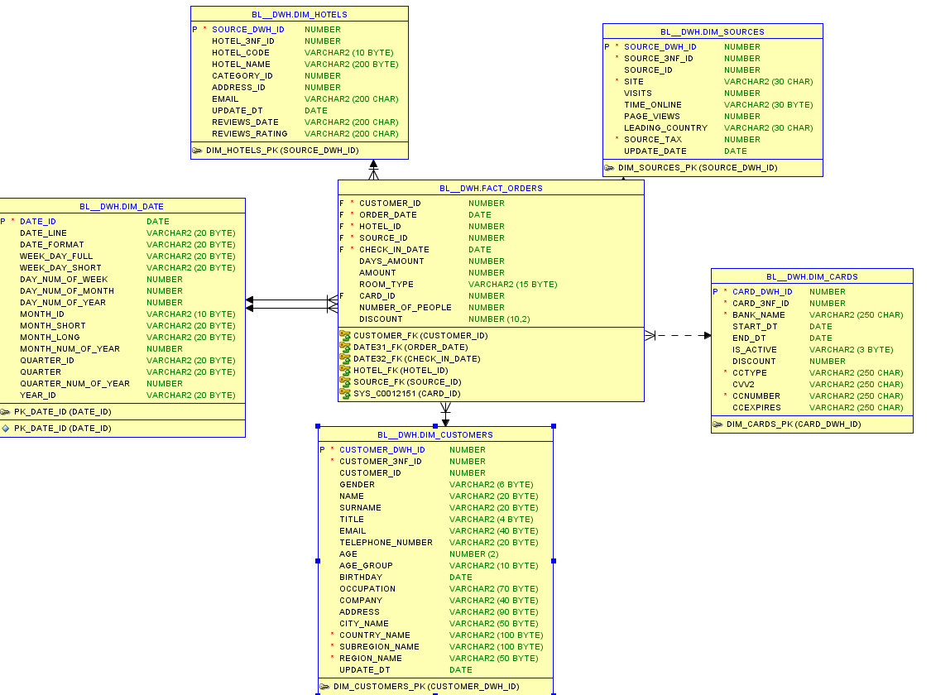
Star schema

Slide 12
Some provided features
EXPLICIT CURSOR
IMPLICIT CURSOR
SCD_2 dimension
* Partitioning

Slide 13
Features
FOR rec IN
( SELECT DISTINCT CCType FROM wrk_customers)
LOOP
INSERT INTO cls_card_types
( CARD_TYPE_ID, CCType )
VALUES
( seq_card_types.nextval, rec.CCType ); END LOOP;

Slide 14
THANK YOU FOR ATTENTION
PROJECT OVERVIEW BY HANNA HUL

